Slide 1
Chapter 1-2 Course Implementation
计算机系统概论
Introduction to Computing Systems
（CS1002A.02）
苗付友
mfy@ustc.edu.cn 2023 Fall
计算机科学与技术学院
School of Computer Science and Technology

Slide 2
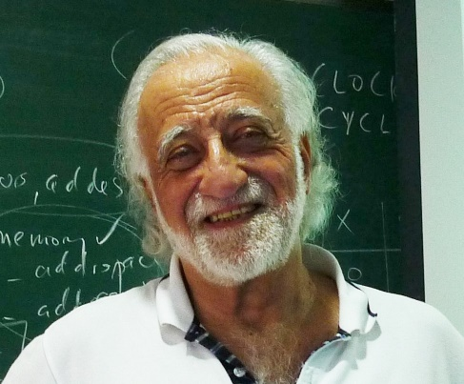
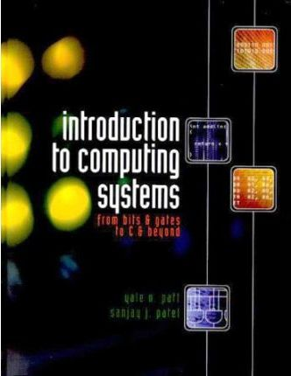
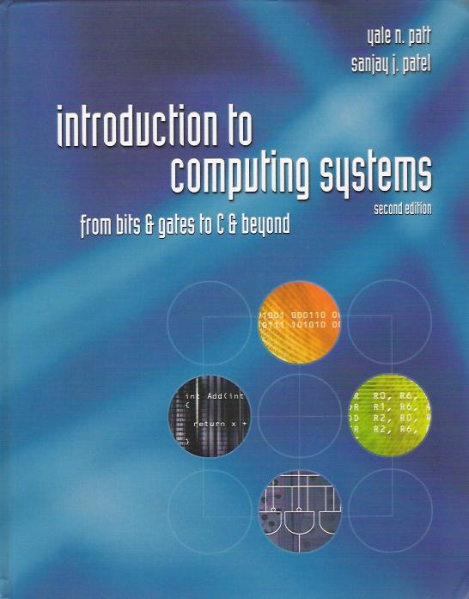
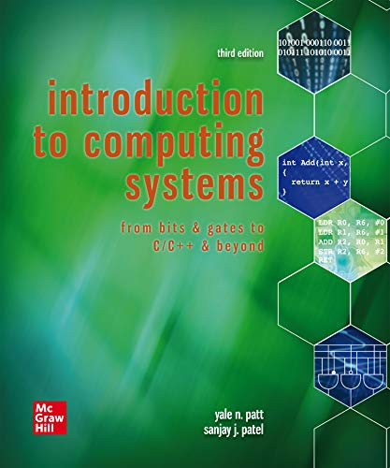
Text Book
Introduction to computer architecture(ISA)
How is data represented?
What are the pieces of a computer?
How do computers work?
Programming
How do I "talk" directly to the machine?-Assembly language
How do I program in “C”?-high level language(HLL)
Computer systems and computation
How do simple HW/SW elements come together to realize complex computations?
Introduction to Computing Systems: from bits and gates to C/C++and beyond(3nd edition),
Yale N. Patt and Sanjay J. Patel， September 2019, McGraw-Hill Higher Education

Slide 3
Text Book Components
Part 1: Hardware(Chapter 1-4)
Representing data, transistors, gates, digital logic structures
von Neumann machine model
Part 2: Software:Assembly language(Chapter 5-10)
Instructions, (structured) programming, input/output, relationship to hardware
Part 3: Software:C programming(Chapter11-19), selected
Syntax, operators, control structures, functions, pointers,recursion, data structures, relationship to assembly language
Assume already familiar with programming (C)

Slide 4
This Course Focus on
Chapt 2 Bits and Bytes
How do we represent information using electrical signals?
Chapt 3 Digital Logic
How do we build circuits to process information?
Chapt 4, 5, 6 Computer Machine Model, Processor and Instruction Set
How do we build a processor out of logic elements?
What operations (instructions) will we implement?
Chapt 7 Assembly Language Programming
How do we use processor instructions to implement algorithms?
How do we write modular, reusable code? (subroutines)
Chapt 8,9,10 I/O, Traps, and Interrupts
How does processor communicate with outside world?
Chapt 11, C Implemention related to Hardware

Slide 5
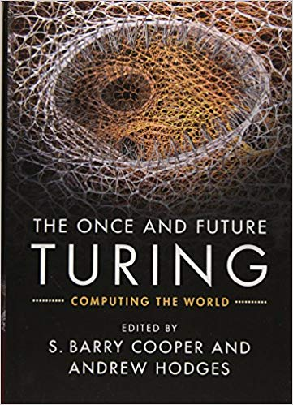
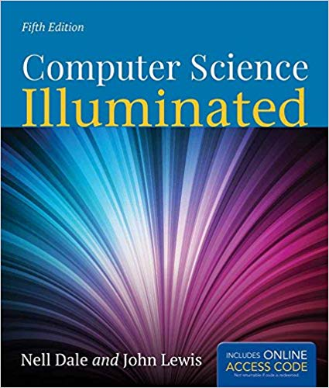
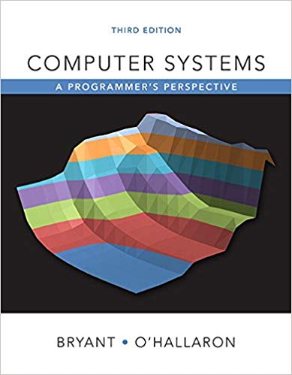
Other Reference Text Books
3
4
1
2
Introduction to Computing Systems: from bits and gates to C/C++ and beyond(3nd edition),
Yale N. Patt and Sanjay J. Patel， June 2019, McGraw-Hill Higher Education
Computer Science Illuminated(5th Edition) ,
D. M. Harris, S. L. Harris, Morgan Kaufmann, San Francisco, 2007
Computer Systems: A Programmer‘s Perspective (3rd Edition) ，
Randal E. Bryant, David R. O’Hallaron，Pearson Education Inc.，2016
The Once and Future Turing: Computing the World （1st Edition），
S. Barry Cooper, Andrew Hodges，Cambridge University Press，2016

Slide 6
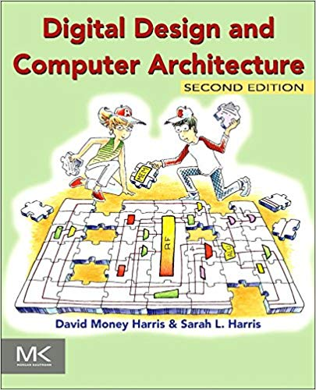
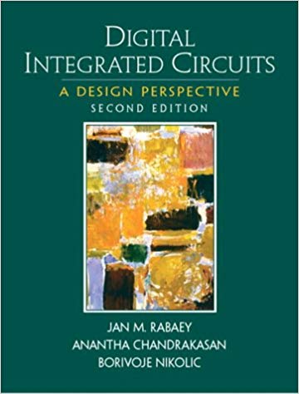
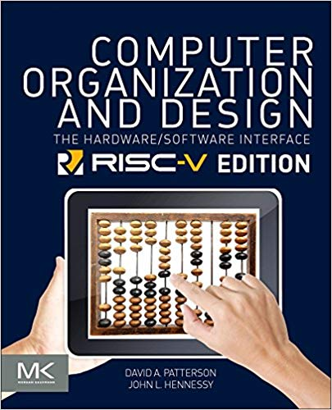
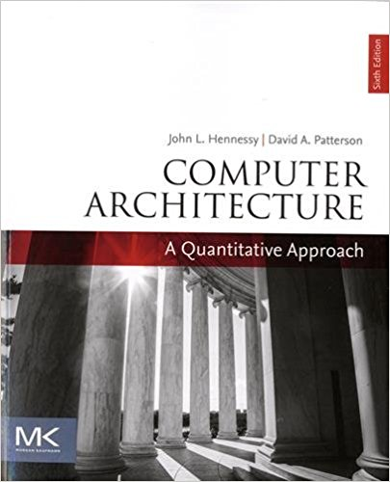
Other Reference Text Books
₅
₆
₇
₈
Digital Design and Computer Architecture（2nd Edition），
David Harris Sarah Harris，p712, Morgan Kaufmann，24th July 2012
Digital Integrated Circuits: A Design Perspective (2nd Edition),
Jan M. Rabaey，Anantha Chandrakasan, Borivoje, Prentice-Hall, Inc，Nikolic,Jan 3, 2003
Computer Organization and Design: The Hardware/Software Interface，
David A Patterson, John L. Hennessy, 5th edition. Morgan Kaufmann Publishers, Inc.，2017
Computer Architecture: A Quantitative Approach，
John L. Hennessy and David A. Patterson， The Morgan Kaufmann，Dec 7, 2017

Slide 7
Background/Prerequisites
Requirement
background in programming(C)
Assume you can program/debug in C
2023/9/6
7

Slide 8
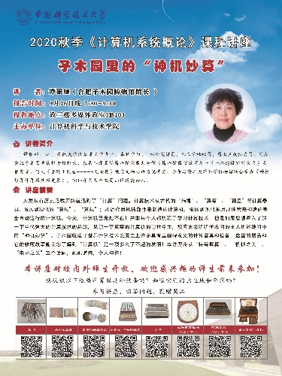
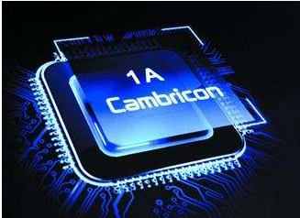
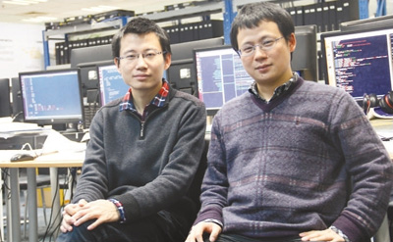
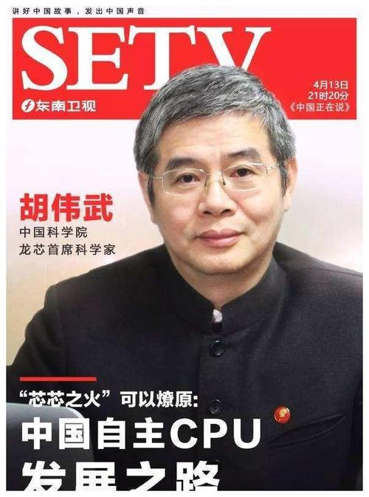
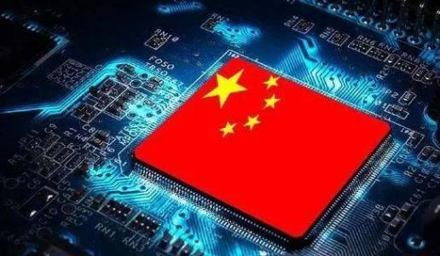
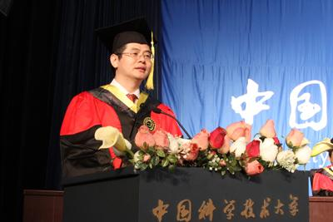
Class Organization
Lectures
Will not simply “cover” the material
Will focus on the “hard stuff”
Will not stand alone, instead build on reading
Guest Lectures
子木园里的神机妙算
Chinese ISA
Cambricon ISA
Discussion sessions
Encouraged! (3 TAs, 3 discussion group, every week! )
Okay: discuss meaning of problem, discuss approaches
Not okay: comparing answers, solving questions together

Slide 9
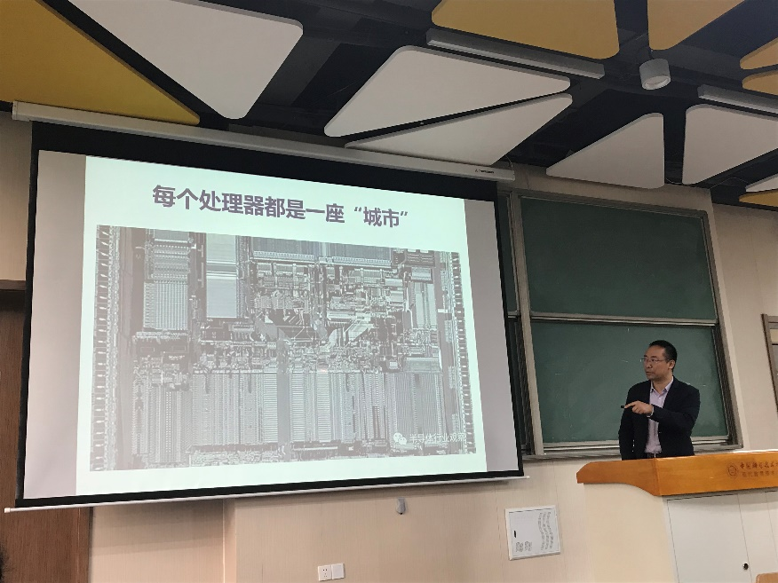
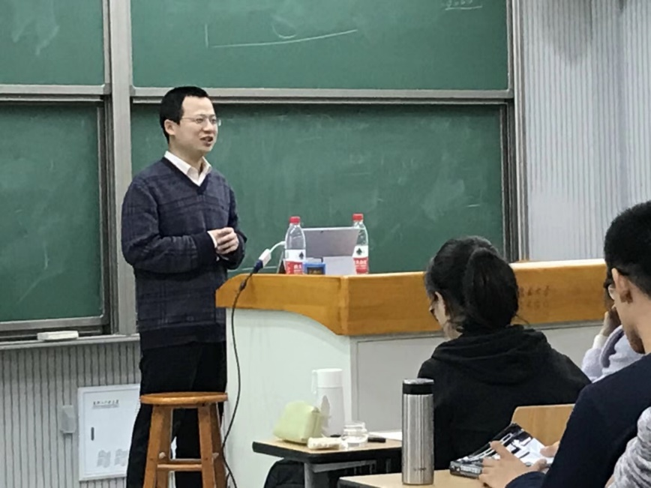
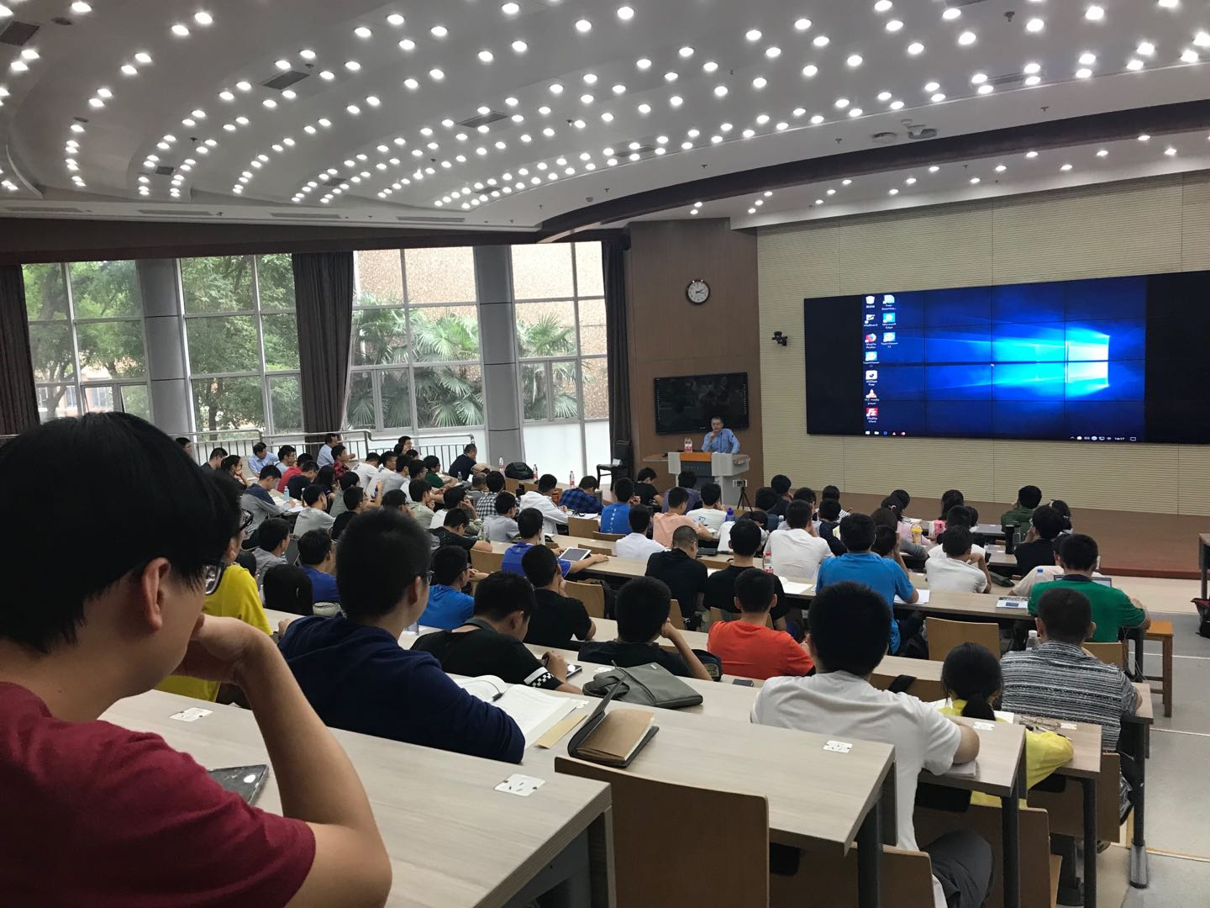
Class Organization in 2018

Slide 10
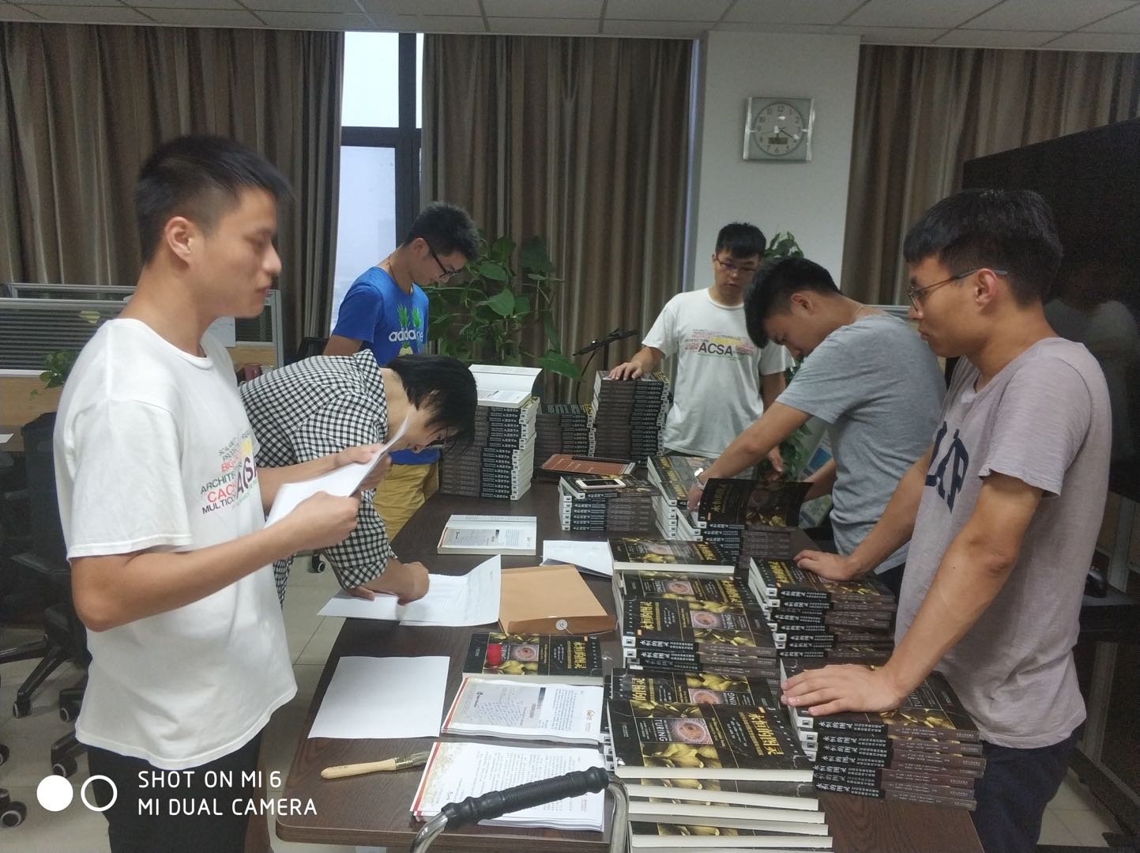
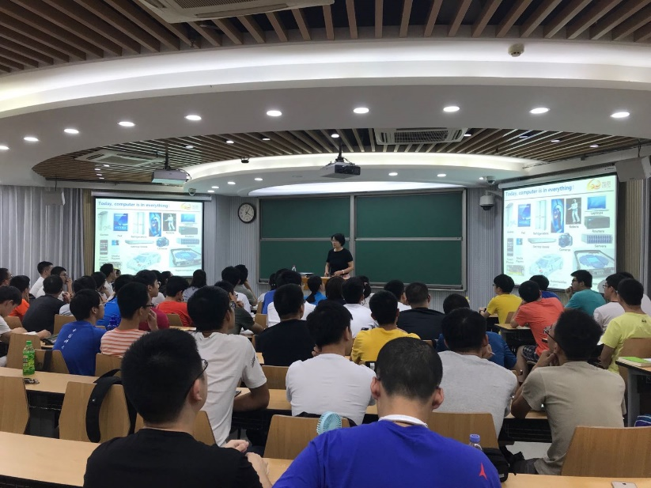
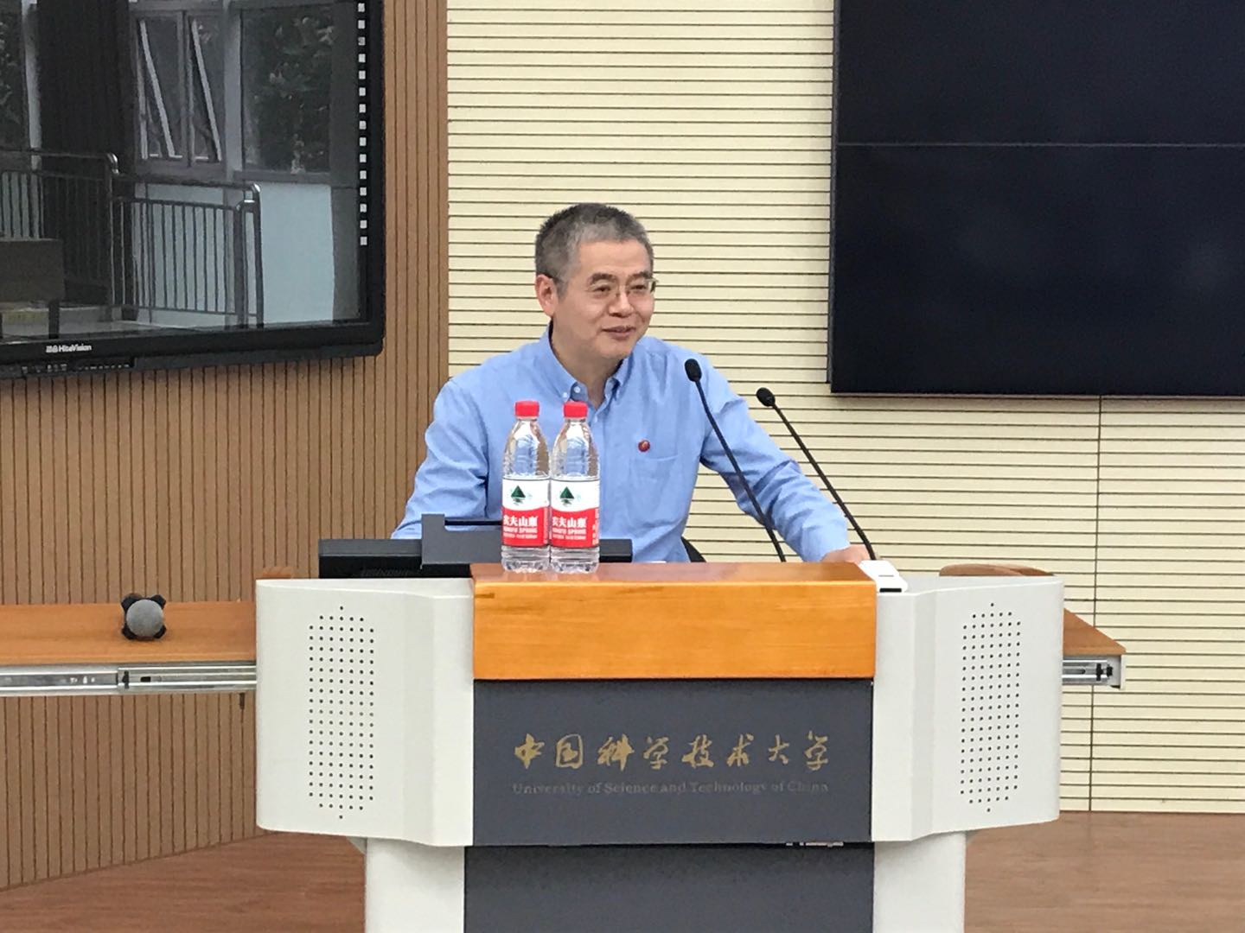
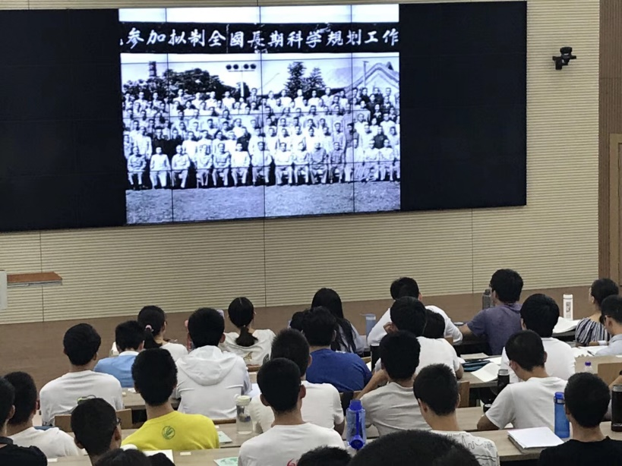
Class Organization in 2018

Slide 11
Class Organization
Labs – LC-3 Simulator /Assembler
All labs start after two weeks
Design Project - Honor class
Simulator/Assembler Design，required
1Midterms + 1 Final
Location: Teaching Building Room 3B102
Date:
September 2 - December 30
Time
2(3,4,5): 9:45-12:10
60 hours+40hours，3+1credit

Slide 12
课堂教学模式：基于讲义（TBL）& 基于案例（CBL）
Lectures
Will not simply “cover” the material
Will focus on the “hard stuff”
Will not stand alone, instead build on reading
Part 1: Hardware(Chapter 1-4)
Representing data, transistors, gates, digital logic structures
von Neumann machine model
Part 2: Software: Assembly language(Chapter 5-10)
Instructions, (structured) programming, input/output, relationship to hardware
Part 3: Software:C programming(Chapter11-19), selected
Syntax, operators, control structures, functions, pointers,recursion, data structures, relationship to assembly language
Assume already familiar with programming (C)

Slide 13
讨论课教学模式：基于问题（PBL)
Discussion sessions
Encouraged! (5TAs for 3 discussion group, every week! )
Okay: discuss meaning of problem, discuss approaches
Not okay: comparing answers, solving questions together
Problem Sets
Problem solving
Complete before each due date
Can work ahead

Slide 14
实践教学模式：基于资源（RBL）
LC-3/RISC-V Simulator/Assembler
Labs Assignments：Simple exercises
Programming Assignments
Programming LC3 Assignments1: Programming In machine language
Programming Assignments2~5:Programming In LC3 assembly language
Programming Assignments6:Assignments2~5:Programming In C
Course Projects：Challenging projects
LC-3 Simulator/Assembler Design(Encouraged! Extra 5 points）

Slide 15
Homework Assignments
Problem Sets
Problem solving
Complete before each due date
Can work ahead
Great exam preparation!

Slide 16
Labs Assignments
Simple Programming Assignments
Programming LC3 Assignments1: Programming In machine language
Programming Assignments2~5:Programming In LC3 assembly language
Programming Assignments6:Assignments2~5 Programming In C
Challenging Course Projects
Programming Assignments7: Assignments2~5 Programming In RISC-V assembly language, (Encouraged! Extra 5 points）
LC3 Simulator /Assembler Design (Encouraged! Honor class required, Extra 5 points）
See schedule for each lab due dates

Slide 17
Exams & Grades
Registering for the course in the first lesson: 1%
Middle Exam: 20%
Final Exam: 30%
Assignments : 36%
6 Programming Assignments: 6% for each program
EPA: Effort, Participation and Altruism in discussion section: 14%
If you do not attend discussion, you can not participate Exam; 14% → 0%
If you don’t do the problems, you can not participate well; 14% → 0%
Encouraged! Extra 10 points → Secure 100 point

Slide 18
EPA vs. GPA
Eﬀort
Attending prof and TA oﬃce hours, completing all assignments, turning in HW, doing reading quizzes
Participation
Attending lecture
Asking great questions in discussion and lecture and making it more interactive
Altruism
Helping others in lab or on Piazza: Be Excellent to Each Other
EPA! points have the potential to bump students up to the next grade level!

Slide 19
Policy on Assignments and Independent Work
ALL PROJECTS WILL BE DONE AND SUBMITTED INDIVIDUALLY.
With the exception of laboratories and assignments that explicitly permit you to work in groups, all homework and projects are to be YOUR work and your work ALONE.
You are encouraged to discuss your assignments with other students, and extra credit will be assigned to students who help others, particularly by answering questions on Piazza, but we expect that what you hand in is yours.
It is NOT acceptable to copy (or even "start with") solutions from other students or the Web

Slide 20
Tips on How to Get a Good Grade
The lecture material is not the most challenging part of the course. You should be able to understand everything as we go along.
DO NOT fall behind in lecture and tell yourself you “will figure it out later from the notes or books”.
Notes will be online after the lecture (usually the weekend night). Do assigned reading before the lecture.
Ask questions in class and stay involved in the class - that will help you understand.
Come to office hours to check your understanding or to ask questions.
Complete all the homework problems - even the difficult ones. The exams will test your depth of knowledge.

Slide 21
Tips on How to Get a Good Grade
You need to understand the material well enough to apply it in new situations. You need to enroll in both the lab and the course.
Take the labs very seriously. They are an integral part of the course.
Choose your partner carefully. Your best friend may not be the best choice!
Most important : Be well organized and neat with homework, labs, project. In lab, add complexity a little bit at a time - always have a working design.

Slide 22
Academic Integrity(学术诚信)
Do not post your work on public repositories like github (private o.k.) --negative points
The rule is simple
Claiming another’s work as your own will ruin your life
See syllabus for details and examples
Who will know?
We will (inspection, similarity detectors, exams)
Your friends will… your parents will…
You will
Remember
If you need to cheat now, you’ve got much bigger problems
Cheating is like going 150 MPH over speed limit while drunk！
2023/9/6
22

Slide 23
Acknowledgements
This course is partly inspired by previous MIT 6.823 and Berkeley CS252 computer architecture courses created by my collaborators and colleagues:
Yale N. Patt(UT)
John Kubiatowicz (UCB)
David Patterson (UCB)
Krste Asanovic (UCB)
Arvind (MIT)
Joel Emer (Intel/MIT)
James Hoe (CMU)

Slide 24
作业
1.5 1.12 1.17 1.23

